Slide 1

HCI - Assignment n.2
Design and prototyping of an application using a human-centered approach
Deliverable n. 1: Requirement Analysis
Project Title: Personal Finance Management App
Group: Jodionísio Muachifi «97147», João Felisberto «98003» & Diogo Santos «98393»
Lab Class: P4
HCI 2021-2022

Slide 2
Introduction
Personal Finance Management App
Finance is important for everyone and it was never easy to manage.
Personal finance is specific to an individual’s situation and activity. Therefore, financial strategies depend largely on the person’s earnings, living requirements, goals and desires.
The purpose of our App is to help people that have little financial literacy.
We intend to develop a user-friendly personal finance management App.
HCI 2021-2022
2

Slide 3
Project Objectives
Personal Finance Management App
High-level goals
Develop an App that permits users to manage their finances in a simple way.
Allow users to plan their savings for short, medium or long-term plans, according to their goals.
Let users strongly control their daily expenses.
Expected outcomes
We aim for a semi-functional application with a minimalist and intuitive interface.
In general, we expect for a semi-functional application that offers a great UI/UX.
The benefits
Provide an easy way for users to organize their savings for their goals.
HCI 2021-2022
3

Slide 4
Personas
Personal Finance Management App
Target Users
People that have little literacy on finance
People with poor money management
HCI 2021-2022
4

Slide 5

Persona 1
Personal Finance Management App
Persona | Scholarship holder
Name, Age, Gender | Ana Bela, 22 y/o, Female
Job | Student at Aveiro University
Background/Environment | She wants to control her daily expenses Currently she notes her expenses on an A4 paper
Needs | She wants an app to help her easily manage her finances
HCI 2021-2022
5

Slide 6
Scenarios
Personal Finance Management App
Ana Bela orders food and wants to register the expense.
Ana Bela's rent goes up, so she needs to readjust the budget
Ana Bela also wants to save money so she can buy herself a car in a few years.
Ana Bela wants to go out tonight, so she checks on the app how much she can spend
HCI 2020-2021
6

Slide 7
Tasks
Personal Finance Management App
Registering movements in the app:
Open spreadsheet
Register name, date and cost
Changing salary/rent value:
In the spreadsheet, select the corresponding line (or cell) and change the value(s)
Repeat until done
Add a goal:
Create table with enough size
Define time interval and amount
Check available balance:
Open spreadsheet
Verify balance
HCI 2021-2022
7

Slide 8
Requirements
Personal Finance Management App
Non-functional requirements
Should be easy and practical to use
Mobile
Persistent
Individual
Functional Requirements
Register expenses associated with category
Create, modify and delete categories
Create, modify and delete saving goals
View expenses, budgets and goals
View how much money of each budget was spent
View how much money was already saved for each goal
Add money to a goal
HCI 2021-2022
8

Slide 9
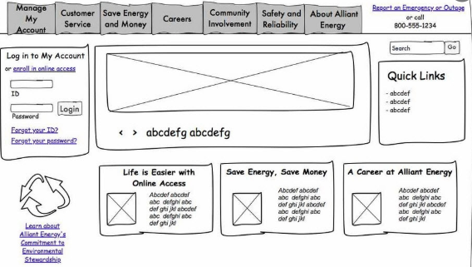
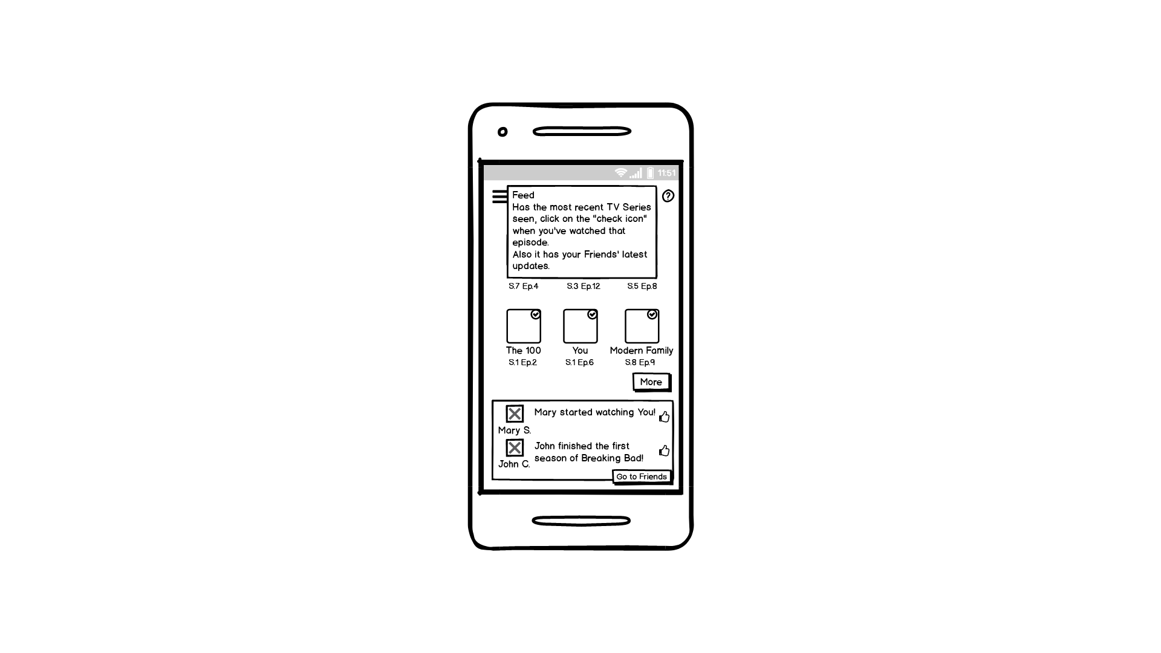
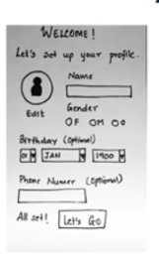
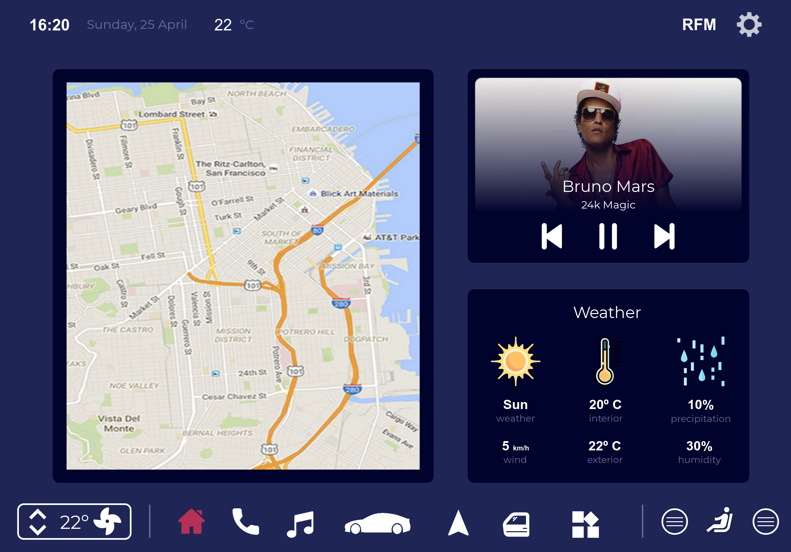
Next steps
Personal Finance Management App
We're considering paper prototype or some low fidelity prototyping technology
But we ponder to use digital
prototype too
We will test it by having potential
users to use the App(e.g.: students)
HCI 2021 - 2022
9

